Slide 1
Security Research
Tamara REZK
INRIA

Slide 2
Objectives
Acquire basic security concepts
Vision on current methodologies and research topics (partial)

Slide 3
Contents
C1 12/9 Cryptography: chosen plaintext attacks
C2 19/9, virtual Vulnerability Finding (Capture the Flag)
C3 26/9 Transient Execution Attacks: Spectre
C4 03/10 special: Scientific Papers
C5 10/10 Symbolic Execution
C6 17/10 Formal Methods for Security
C7 24/10 Research project (2 people)
Final presentation (Research project) : Starting on 7/10 (20’)

Slide 4
Material
C1 12/9 Cryptography: chosen plaintext attacks
Security Analysis of ElGamal Implementations
https://wwwsop.inria.fr/lemme/Tamara.Rezk/publication/SecryptElGamal.pdf
C2 19/9, virtual Vulnerability Finding (Capture the Flag)
ttps://whiterabbithole.se/inria/
https://picoctf.org/
C3 26/9 Transient Execution Attacks: Spectre
Spectre Attacks: Exploiting Speculative Execution
https://spectreattack.com/spectre.pdf

Slide 5
Material
C4 03/10 special: Scientific Papers
Virtual 9h-10h : Distribution of papers, small explanation, choose presentation time
10–12h45 reading (individual)
Homework: prepare summary and presentation
C5 10/10 Symbolic Execution
Symbolic Execution for Software Testing: Three Decades Later
https://people.eecs.berkeley.edu/~ksen/papers/cacm13.pdf
C6 17/10 Formal Methods for Security: noninterference security property
A sound type system for Secure Information Flow
https://people.mpi-sws.org/~dg/teaching/lis2014/modules/ifc-1-volpano96.pdf

Slide 6
Grading
- Each lesson, 1 exercise TP (individual), 5 correct exercises on given deadlines (not mandatory to do 5), 20 points (N1) → possibility of promotion
- Research project based on one of the papers seen during the lessons, 20 points (N2, not mandatory)
Final grade = ½ N1 + ½ N2

Slide 7
Security: basic concepts

Slide 8
Security (Ultimate Goal)
Protect systems’ confidentiality, integrity, availability
Confidentiality: attacker should not read system’s secrets
Integrity: attacker should not write system’s sensitive data
Availability: attacker should not influence the availability of a system

Slide 9
Threat model (Research)
A threat model is used in research to precisely define
what is the power of an attacker we defend against
Example: attacker model for Chosen Plaintext Attacks Indistinguishability or IND-CPA (Cryptography):
The attacker can see the ciphertext
The attacker can encrypt plaintexts of his/her choice
The attacker cannot see the decryption key
- The attacker cannot probe each decryption key in polynomial time w.r.t the length of the key.

Slide 10
CVE: Common Vulnerabilities and Exposures
https://www.cve.org/
Database of common vulnerabilities
Each vulnerability has a unique identifier and sometime also a
PoC (Proof of Concept), which demonstrate how the vulnerability works
Ethical security: once a system’s vulnerability is discovered, we inform the system’s owners about it (responsible disclosure) and agree with them on the time to publicly announce it (twitter and/or research publication)

Slide 11
Top Security Conferences
Hacker conferences: Blackhat https://www.blackhat.com/
Scientific conferences:
IEEE Security & Privacy https://www.ieee-security.org/TC/SP2022/
ACM CCS: https://www.sigsac.org/ccs/CCS2022/
NDSS: https://www.ndss-symposium.org/
Usenix Security:https://www.usenix.org/conference/usenixsecurity22

Slide 12
A bit of terminology
“pwn” : to compromise or control a system (from “own)
“pwnie awards”: excellent or incompetence award for security (announce at Black Hat)

Slide 13
IND-CPA (confidentiality)
Cryptography: chosen plaintext attacks

Slide 14
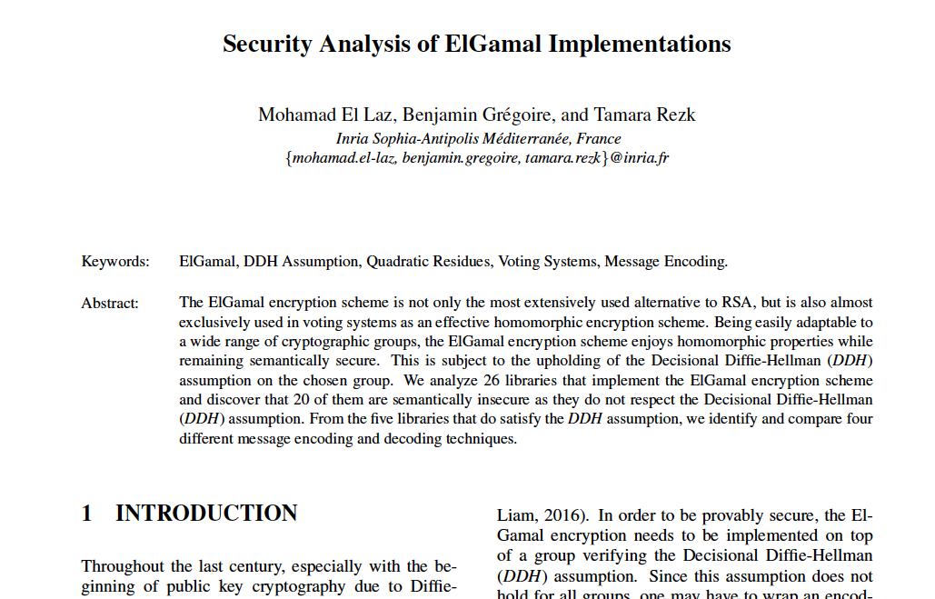

Slide 15
A chosen plaintext attack (CPA) against ElGamal:
ElGamal is an encryption scheme
CPAs are attacks against confidentiality of an encryption scheme
Attacker model:
The attacker can see the ciphertext
The attacker can encrypt plaintexts of his/her choice
The attacker cannot see the decryption key
- The attacker cannot probe each decryption key in polynomial time w.r.t the length of the key.

Slide 16
ElGamal is IND-CPA using the following definition:
Let p a safe prime number, G a prime order group with operation *, and g its generator, then we define ElGamal as:
Key generation d : = {1 …, q-1} ; e : = g^{d}
Encryption(m,e) r: = {1 …, q-1} ; c1 : = g^{r} ; c2 :=m*e^{r} , where m belongs to G
Encryption(c1,c2,d) m:= c2/c1^{d}

Slide 17


A chosen plaintext attack against ElGamal:
Let p a safe prime number, G a prime order group with operation *, and g its generator, then we define ElGamal as:
Key generation d : = {1 …, q-1} ; e : = g^{d}
Encryption(m,e) r: = {1 …, q-1} ; c1 : = g^{r} ; c2 :=m*e^{r} , where m belongs to G
Encryption(c1,c2,d) m:= c2/c1^{d}

Slide 18
A chosen plaintext attack against ElGamal:
Confidentiality : an attacker can see ciphertext (c1, c2) but cannot deduce anything on what is the message encrypted
Attack: Given (c1,c2) encrypting m and (c1’, c2’) encrypting m’, the attacker may know if m=m’
How: if the underlying group is not of prime order, by using quadratic residuos
Key generation d : = {1 …, q-1} ; e : = g^{d}
Encryption(m,e) r: = {1 …, q-1} ; c1 : = g^{r} ; c2 :=m*e^{r} , where m belongs to G
Encryption(c1,c2,d) m:= c2/c1^{d}

Slide 19
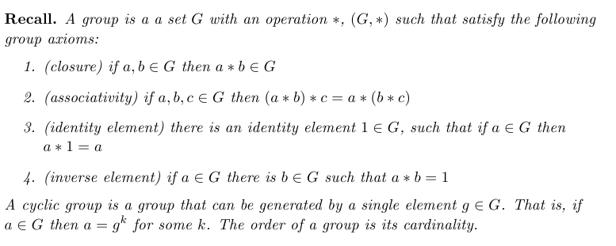
Groups
If g is a generator of a cyclic group, no efficient algorithm (polynomial in the order of the group) to compute log_{g} g^{x} is known.

Slide 20
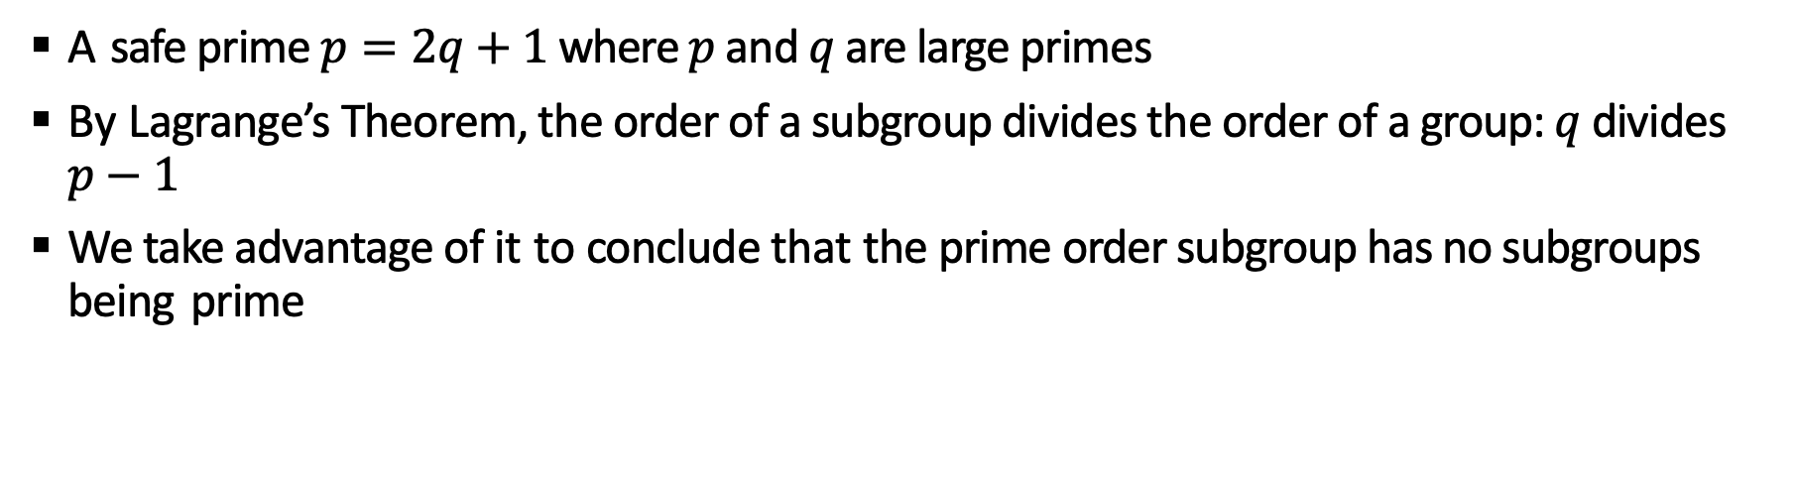
Safe prime
A safe prime $p=2q+1$where $p$ and $q$ are large primes
By Lagrange’s Theorem, the order of a subgroup divides the order of a group: $q$divides $p−1$
We take advantage of it to conclude that the prime order subgroup has no subgroups being prime

Slide 21
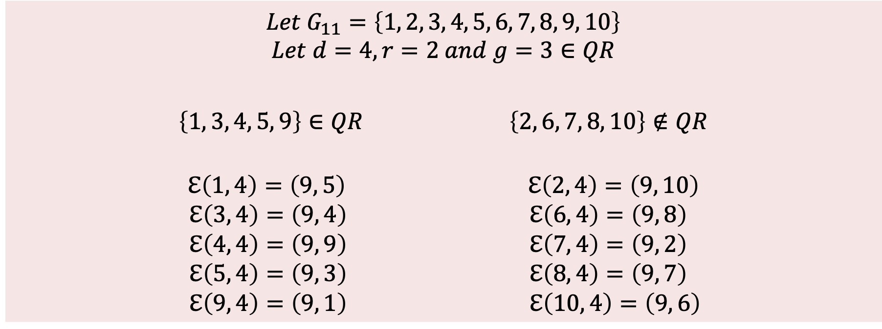
Quadratic Residuos (QR) messages
Example of a group of order 10
$$Let G_{11}=\left\{1, 2, 3, 4, 5, 6, 7, 8, 9, 10\right\}$$
$$Let d=4, r=2 and g=3∈QR$$
$\left\{1, 3, 4, 5, 9\right\}∈QR \left\{2, 6, 7, 8, 10\right\}∉QR$
$$ℇ\left(1, 4\right)=\left(9, 5\right) ℇ\left(2, 4\right)=\left(9, 10\right)$$
$$ℇ\left(3, 4\right)=\left(9, 4\right) ℇ\left(6, 4\right)=\left(9, 8\right)$$
$$ℇ\left(4, 4\right)=\left(9, 9\right) ℇ\left(7, 4\right)=\left(9, 2\right)$$
$$ℇ\left(5, 4\right)=\left(9, 3\right) ℇ\left(8, 4\right)=\left(9, 7\right)$$
$$ℇ\left(9, 4\right)=\left(9, 1\right) ℇ\left(10, 4\right)=\left(9, 6\right)$$

Slide 22
Quadratic residuos (QR)
x ∈ QR_{q} ⇔ ∃ b b²≡ x (mod q)

Slide 23
Quadratic residuos (QR)
Algorithm that given q and a in Z*_{q} returns J_{q}(a):
Alg Test_SQ (q, a)
s = = a^{(q-1)/2} (mod q)
return s
This yields a cubic-time algorithm to compute the Jacobi symbol.

Slide 24
Quadratic residuos (QR)
x ∈ QR_{q} ⇔ ∃ b b²≡ x (mod q)
Fact: If q ≥ 3 is a prime then for any x, y
J_{q}(xy) = J_{q}(x) J_{q}(y)
J_{q}(x⁻¹) = J_{q}(x)

Slide 25
ElGamal is IND-CPA using the following definition:
Let p a safe prime number, G a prime order group with operation *, and g its generator, then we define ElGamal as:
Key generation d : = {1 …, q-1} ; e : = g^{d}
Encryption(m,e) r: = {1 …, q-1} ; c1 : = g^{r} ; c2 :=m*e^{r} , where m belongs to G
Encryption(c1,c2,d) m:= c2/c1^{d}

Slide 27
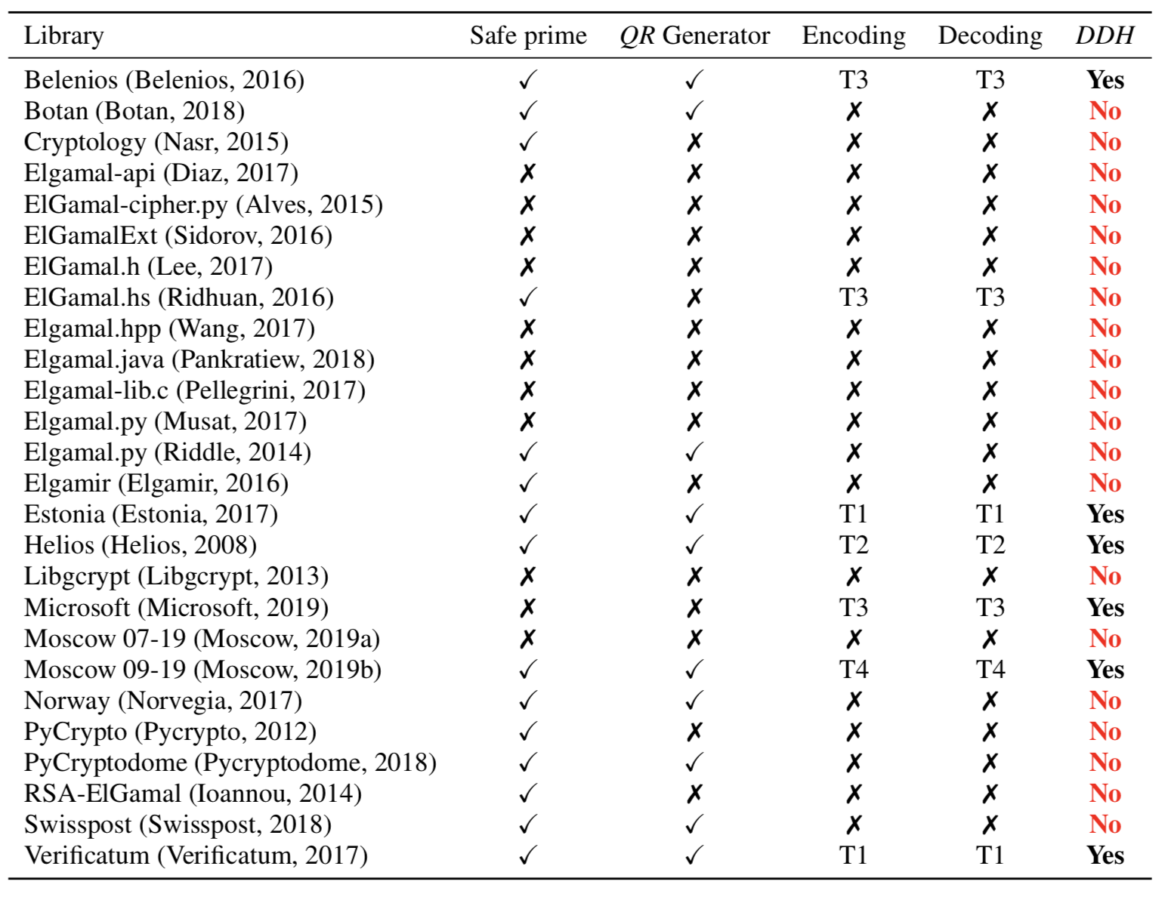

Slide 28
TP : https://ocaml.org/docs/up-and-running
Choose one QR message and one non QR message.
Use the provided OCaml ElGamal implementation to encrypt twice the QR message and twice non QR messages.
Build a distinguisher that given two ciphertexts as input distinguish weather the ciphertext correspond to the the same message or not.
Read the associated paper
Correct ElGamal implementation to obtain an IND-CPA version.

